Slide 1




BUYING USED CARS MADE AFFORDABLE.
With Carsemba, We Put You On Track

Slide 2

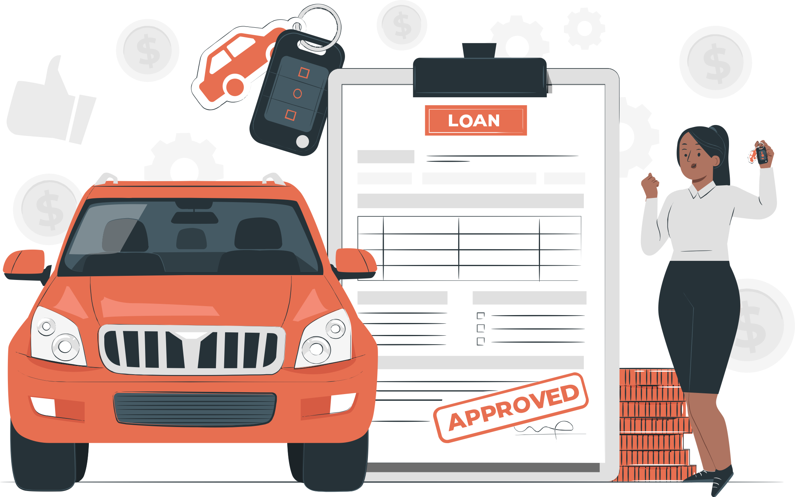
Objective
Carsemba is a platform that makes it easy for anyone to acquire the car that they want regardless of their credit score or their current budget. With Carsemba you get to buy now and pay later in installments.

Slide 3




Problems
Companies offer impersonal and cold service to customers, letting them experience rough investigations, and negatives from the banks. When it comes to buying used cars there are many factors that come into play.
Price:
Reliability:
Time:
Buying a car from a dealership the price is usually very high and they leave no room for negotiations, usually leaving the buyer with only 2 options (finance or pay full cash). And even if with a private seller there is room for negotiations the buyer usually tends to only have one option which is to have the full payment ready.
As a buyer I want to know that the car that I am buying will be 100% reliable. Most private sellers sell their cars “as is,” leaving the buyer stuck with whatever problems pop up. Car dealerships can also be very intimidating especially if you don’t know too much about cars. The problem is that most salesmen work on commission. They don’t have enough rooms to answer all your questions, it’s in their best interest to get you to drive home with any car no matter what while pocketing as big a profit as they can.
As we know, time is money and truth be told buying a car from a dealership feels like an eternity, so much paperwork to fill out this can usually take 1 to 2 days. Buying a car from private sellers takes even longer because it’s your job to search all over town if you want to find something good and after finding that you must bring the vehicle for inspection
and registration.

Slide 4

Solutions
Been aware of all the processes and customer needs involved in the selling and
buying car management processes, achieving business goals and providing the
best customer experience.
Price:
Buying a car from Carsemba is literally the cheapest way that has never been invented. First, we give our users a spending limit based on their income. By doing this we’re helping the buyer find something good and affordable that they will be able to pay. You don’t need to get a loan or even having the full amount, once you have selected the car that you want, Carsemba will take care of paying the seller upfront and you as the buyer will choose the best way that fits you to pay us back with an installment as low as $200 every week.
Reliability:
Time:
Carsemba comes with a 7 days warranty, meaning after 7 days of purchasing your vehicle, if you notice any issue with the car, you can contact us, and your vehicle will be taken care by us free of charge.
The buying car procedure only takes less than 5 minute, and you can get your car ready to drive as soon as the same day

Slide 5

Brand Positioning
In this section we must answer this three main questions:
Who are we?
How we do it?
Why are we important to the others?

Slide 6

Who we are
We are the platform that connects car sellers and car buyers to find the perfect match for them. We help them through the entire budget and verification management and in a simple, secure and smart way.
How we do it
We understand the importance and how complicated the selling process could be and the stress that it represents. No matter if they are the buyer or seller, both sides have the stress factor present.
We take care of every detail in their selling process, like every person, student or seller has unique needs and everyone is divergent. We will calculate the buyer’s income, verify it and offer them a spending limit to find their perfect vehicle. Then we will pay the seller upfront, and the buyer can pay in installments.
Why we do it
We want to provide a service with much more transparent and simpler online shopping processes that favor all people, creating a platform that represents confidence while certifying our veracity and giving the purchase process reliability, transparency, and guarantee, features that help buyers and sellers feel safe throughout the purchase or selling of their new vehicle.
Nowadays buying a car represents one of the most important decisions of a person, it is a factor that represents a part of their independence, and it is a decision that is not taken lightly, sometimes because of the divergent customer contexts, the possibility to get a car can be reduced to zero because of them
budget or credit history.
At the same time, the online channel is proving to be a great tool in the process of buying a car. Although 100% of purchases are not yet made through the Internet, visiting specialized pages or the websites of dealers is the best way for potential buyers to access the information they need when purchasing a new vehicle.

Slide 7
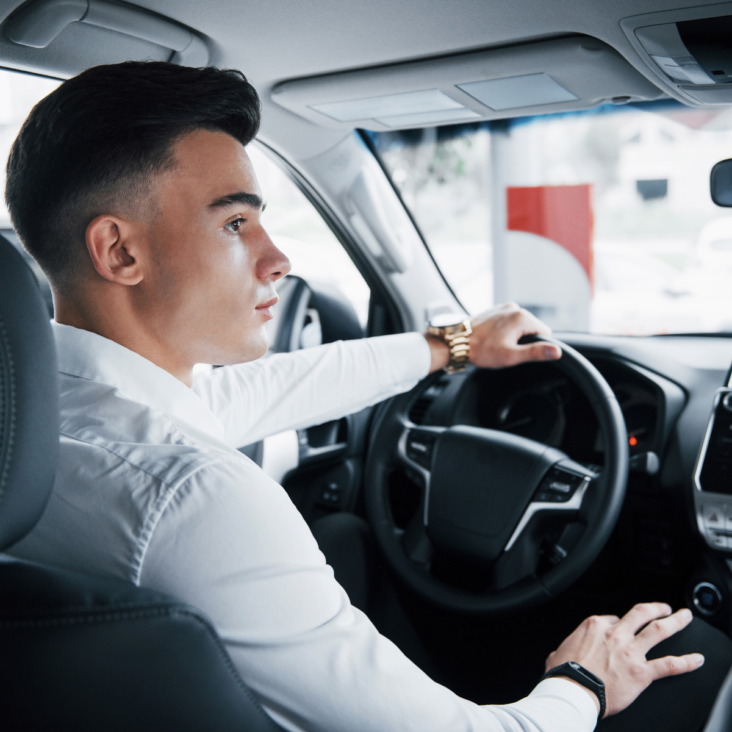



Target Audience
Carsemba is for the college students who live off campus, they need something reliable and affordable for the day-to-day commute. They don’t need to go take more car loans on top of the school loans that they already have for them to get something good..
We are also targeting young professionals from age 18 - 30, this is usually someone who lives from paycheck to paycheck, because of life circumstances they don’t have good credit. If someone like this was to go to a dealer to finance a car the bank would have taken advantage of them with a high interest rate.

Slide 8

Market Size
$160.4 billion used car dealers in the US market size in 2022
Market growth will ACCELERATE at a CAGR of
Growth Contributed by US
100%
1.98%
Incremental growth (MN UNITS)
Growth for 2021
3.91
1.55%
2020
2025

Slide 9

Business Model
Carsemba doesn’t directly buy cars from sellers, we let anyone both private sellers
and dealers, list their vehicles on our platform for free. When a buyer shows
interest in buying the vehicle Carsemba will then pay the seller the full amount
and charge the buyer a 6% interest rate on the issued loans which then the buyer
will choose to pay over the course of installments.

Slide 10



How it works
If they choose a weekly payment, the buyer will pay us $198.75 for 24 weeks which is 6 months then the car will fully be theirs.
If they choose bi-weekly payment, the buyer will pay us $397.50 for 12 fornites which is 6 months the car will fully be theirs.
If the seller is selling their vehicle for $5000, the car will be sold on our platform for $5300 with a 6% interest added to it
Buyer will choose the payment system that best works for them which is weekly or bi-weekly.
To finalize everything the buyer will pay a 10% down payment So If you take the $5300 - $530 [10% down payment] = $4770.

Slide 11
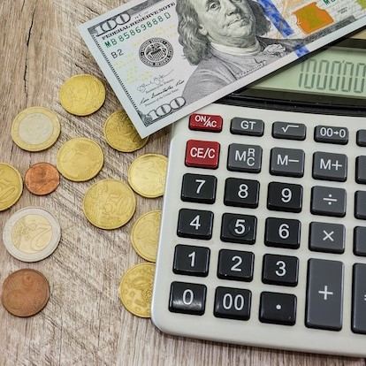
Escrow Payment
Carsemba escrow account is specially created to help a buyer who has bad credit history to prove that they are responsible and committed while at the same time they are trying to repair credit by saving for a car. Customers need to fulfill needs under one stop shop as we provide an opportunity for bad credit people to buy a car under our escrow system to save and buy in the future.

Slide 12
Carsemba Payment Strategy
Carsemba gets the car from the seller and delivers it to the buyer.
The car will be delivered to the customer, who has 7 days to test the car.
If the car is in good working order, the customer keeps the car.
If the car is not in good working order, it is repaired by our shop for free.
The car is then sent to the buyer and the cost for repairs is deducted from the total the customer owes for the vehicle.

Slide 13



Benefits of Escrow System
Secure payment option for both parties
Multiple funding and disbursement options
Money back guaranty to withdraw from the contract
The verified process follows the compliance rules

Slide 14
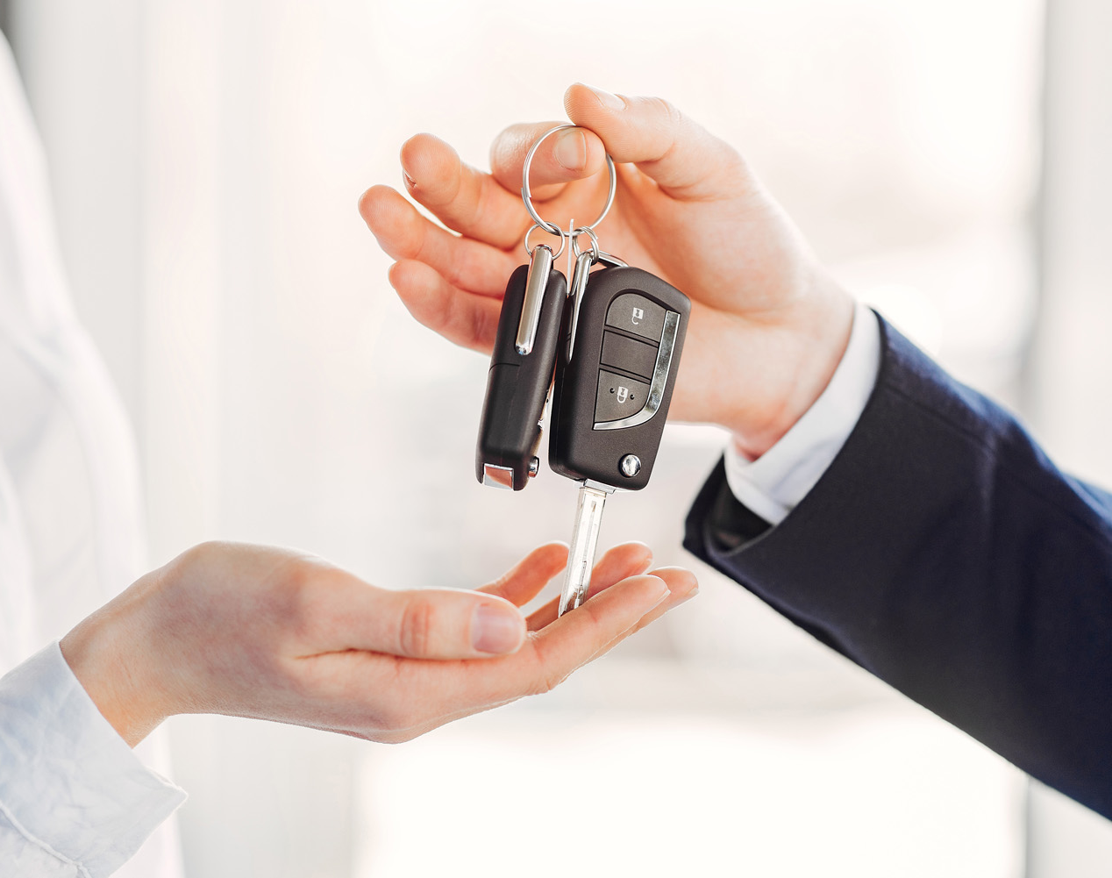
Competitors
Direct competitors, none. Carsemba doesn’t have a direct competitor because no
one is doing what we’re getting ready to do
Indirect competitors: Carvana, Carfax, Vroom, Craigslist, Offer up, etc...

Slide 15


Our mission
To transform the selling and buying car management experience, for our customers, driven by close, clear and strong relationship with them, combined with the secure, confident and simple methodologies used in the company.

Slide 16


Financial
Our vision
We’re looking to raise a
$2 million investment.
Keep growing as transformers of the car selling sector and lead the transactions platforms. Being aware of the current context and becoming their first payment option for customers and reference in the market, leading the top minds of our customer’s choices.
$1.5 million investment to pay for 50 used cars at a cost of $30,000 and to also establish our first office in Boston and hire more talented people in our team. The 50 used cars will translate to a $1.7 million revenue over 12 months. And $500,000 to establish our office in the Boston area and bring some talented people in the team.

Slide 17
Financial
Project Cost
Project Cost
Pre-Operational Expenses | 185,750
Premises | 225,000
Vehicles | 1,500,000
Office Equipment | 39,250
Total Project Cost | 1,950,000
Working Capital | 50,000
Total Investment Required | 2,000,000

Slide 18
Financial
Profit & Lost
Profit & Loss Accounts | Year 1 | Year 2 | Year 3 | Year 4 | Year 5
Revenue | 1,700,000 | 1,733,660 | 1,767,986 | 1,802,993 | 1,838,692
Cost of Services | 595,000 | 606,781 | 618,795 | 631,047 | 643,542
Gross Profit / (Loss) | 1,105,000 | 1,126,879 | 1,149,191 | 1,171,945 | 1,195,150
Administrative Expenses | 340,000 | 346,732 | 353,597 | 360,599 | 367,738
Selling & Marketing Expenses | 170,000 | 173,366 | 176,799 | 180,299 | 183,869
Depreciation | 85,000 | 86,683 | 88,399 | 90,150 | 91,935
Finance Cost | - | - | - | - | -
Tax | 107,100 | 109,221 | 111,383 | 113,589 | 115,838
Net Profit / (Loss) | 402,900 | 410,877 | 419,013 | 427,309 | 435,770

Slide 19
Financial

Slide 20




Team
Gerard Kasemba
Frontend developer, Founder and CEO
Narendra Bhatt
Software Engineer
Location: Boston, MA, USA
Location: Nepal
Shubham Bhatta
Anjal Bam
Software Engineer and CTO
Frontend Developer
Location: Nepal
Location: Nepal

